Slide 1
CLASSIFICATION- using ML
Prof. Ketan Sarvakar
‹#›

Slide 2
Classification: Basic Concepts
Classification: Basic Concepts
Decision Tree Induction
Bayes Classification Methods
Rule-Based Classification
Model Evaluation and Selection
Techniques to Improve Classification Accuracy: Ensemble Methods
Summary
‹#›

Slide 3
Supervised vs. Unsupervised Learning
Supervised learning (classification)
Supervision: The training data (observations, measurements, etc.) are accompanied by labels indicating the class of the observations
New data is classified based on the training set
Unsupervised learning (clustering)
The class labels of training data is unknown
Given a set of measurements, observations, etc. with the aim of establishing the existence of classes or clusters in the data
‹#›

Slide 4
Prediction Problems: Classification vs. Numeric Prediction
Classification
predicts categorical class labels (discrete or nominal)
classifies data (constructs a model) based on the training set and the values (class labels) in a classifying attribute and uses it in classifying new data
Numeric Prediction
models continuous-valued functions, i.e., predicts unknown or missing values
Typical applications
Credit/loan approval:
Medical diagnosis: if a tumor is cancerous or benign
Fraud detection: if a transaction is fraudulent
Web page categorization: which category it is
‹#›

Slide 5
Classification—A Two-Step Process
Model construction: describing a set of predetermined classes
Each tuple/sample is assumed to belong to a predefined class, as determined by the class label attribute
The set of tuples used for model construction is training set
The model is represented as classification rules, decision trees, or mathematical formulae
Model usage: for classifying future or unknown objects
Estimate accuracy of the model
The known label of test sample is compared with the classified result from the model
Accuracy rate is the percentage of test set samples that are correctly classified by the model
Test set is independent of training set (otherwise overfitting)
If the accuracy is acceptable, use the model to classify new data
Note: If the test set is used to select models, it is called validation (test) set
‹#›

Slide 6
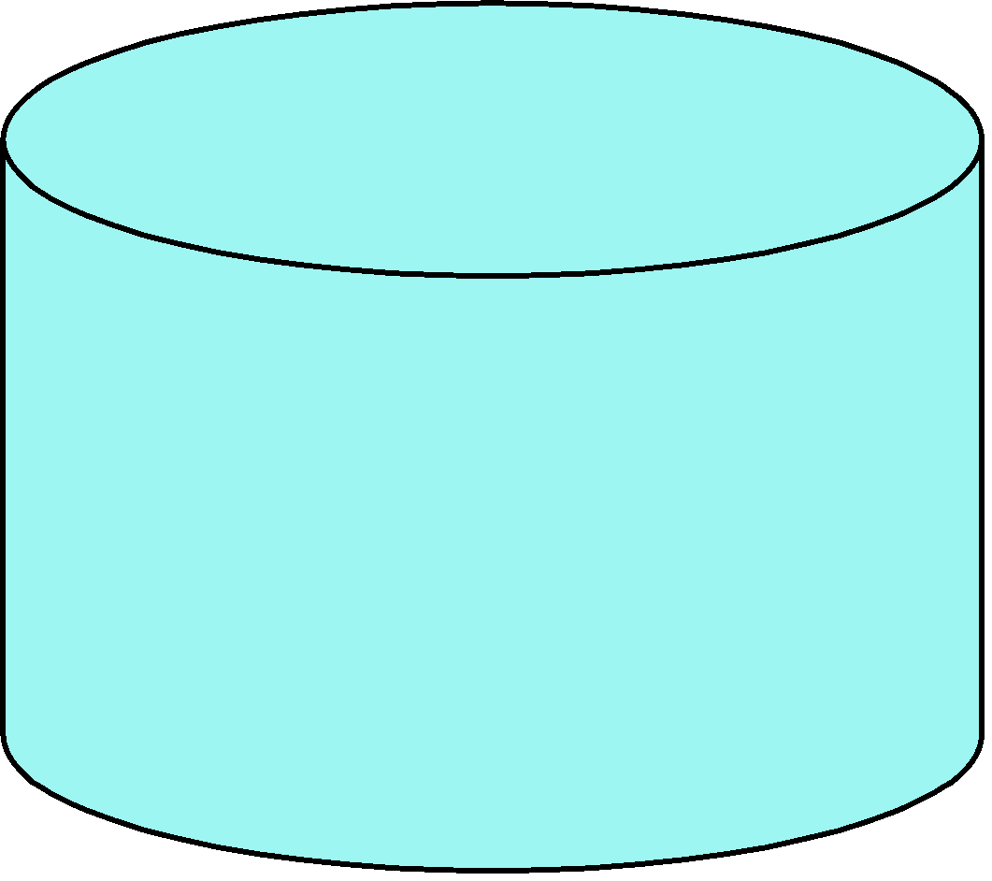
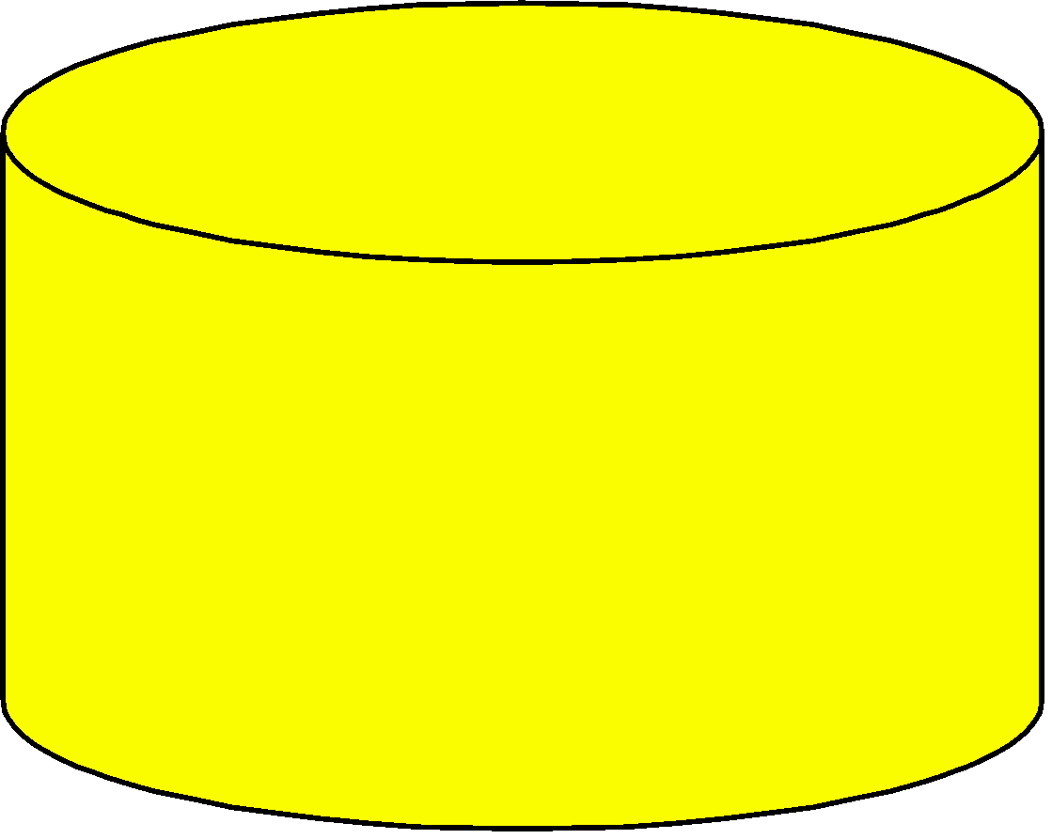
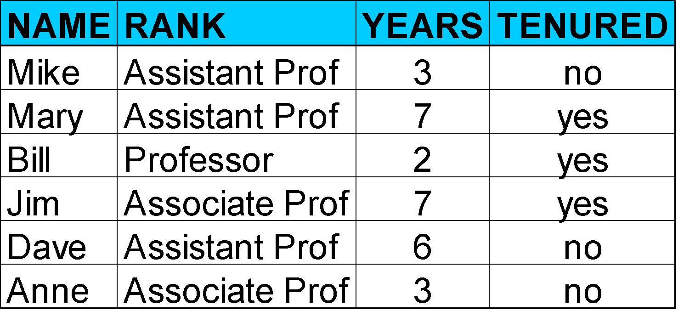
Process (1): Model Construction
Classification
Algorithms
Training
Data
Classifier
(Model)
IF rank = ‘professor’
OR years > 6
THEN tenured = ‘yes’
‹#›

Slide 7
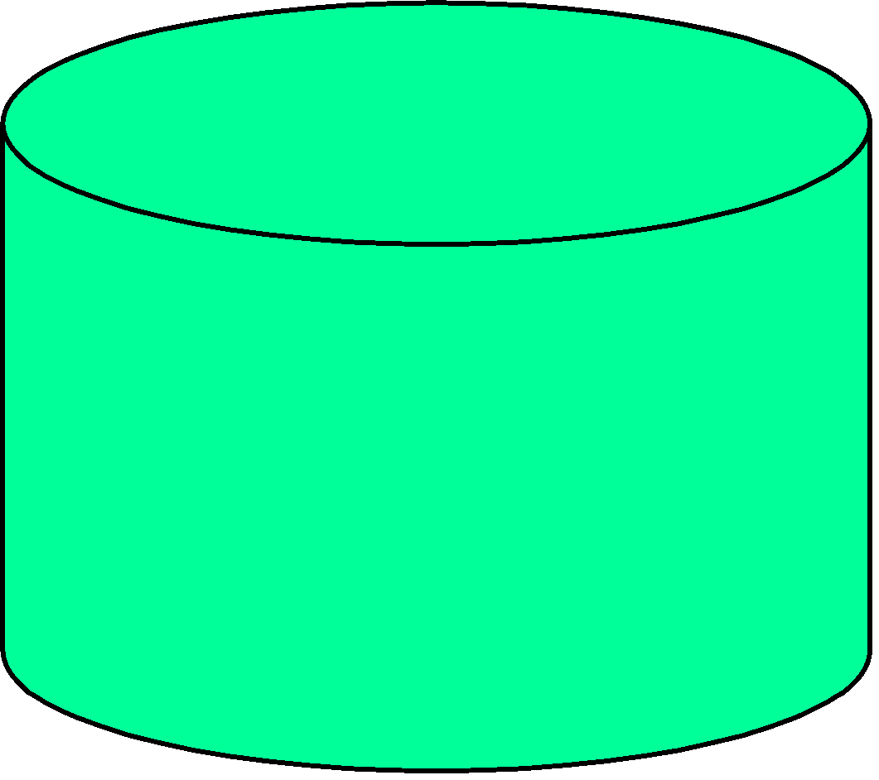
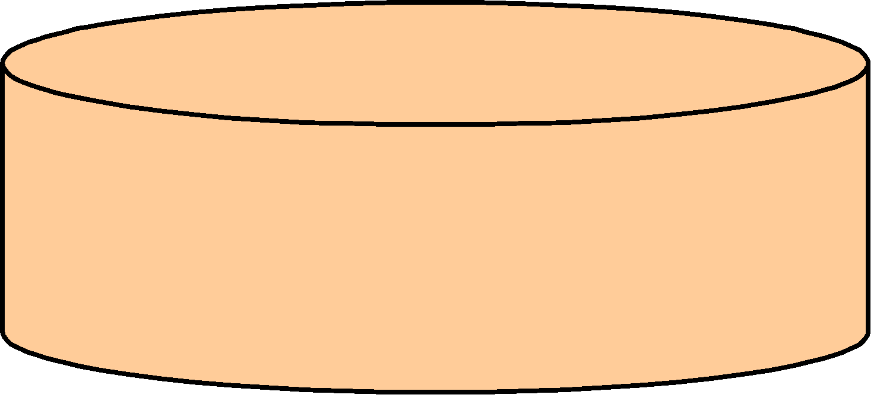

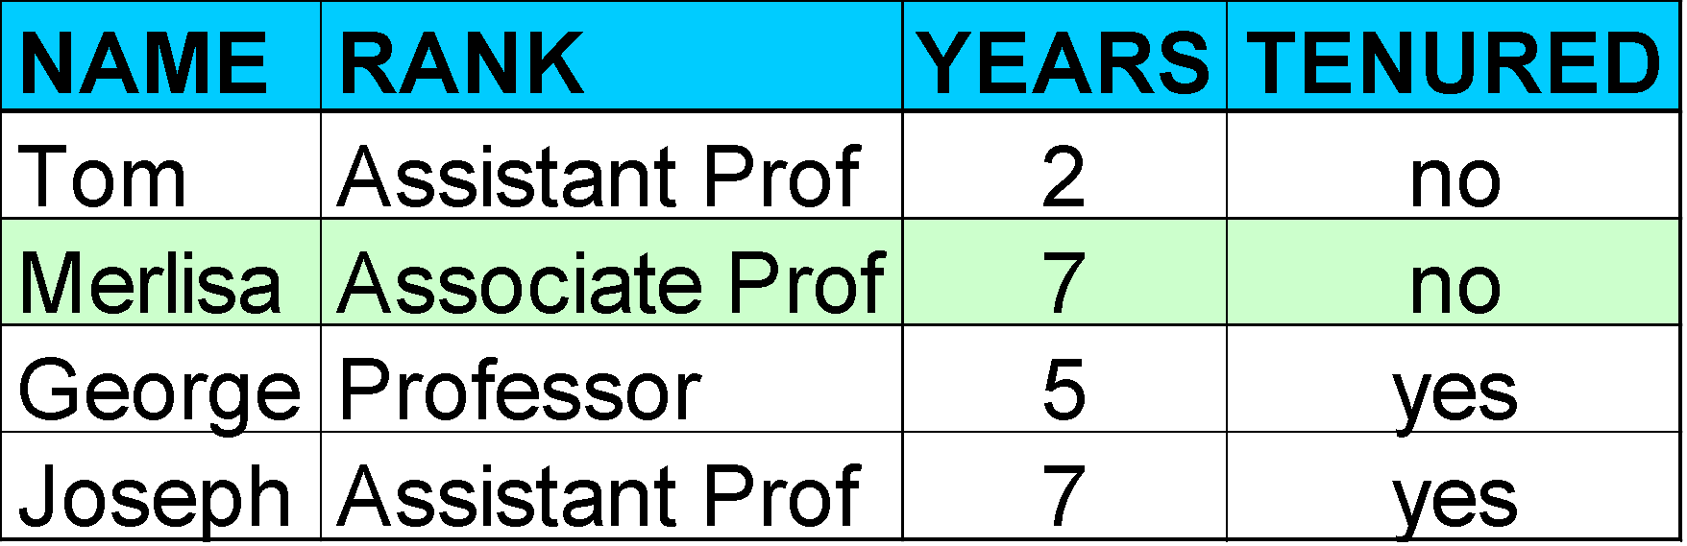
Process (2): Using the Model in Prediction
Classifier
Testing
Data
Unseen Data
(Jeff, Professor, 4)
Tenured?
‹#›

Slide 8
Chapter 8. Classification: Basic Concepts
Classification: Basic Concepts
Decision Tree Induction
Bayes Classification Methods
Rule-Based Classification
Model Evaluation and Selection
Techniques to Improve Classification Accuracy: Ensemble Methods
Summary
‹#›

Slide 9
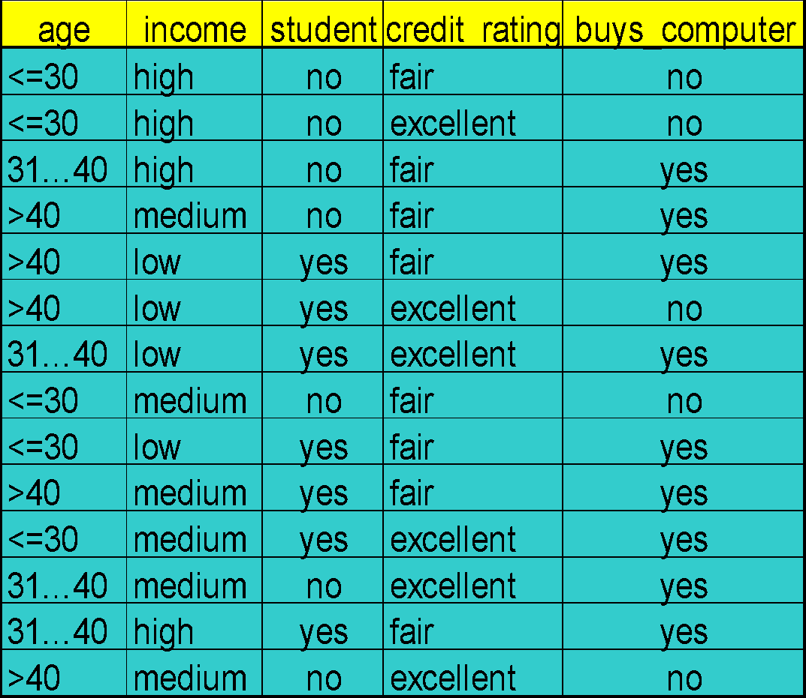
Decision Tree Induction: An Example
Training data set: Buys_computer
The data set follows an example of Quinlan’s ID3 (Playing Tennis)
Resulting tree:
age?
<=30
overcast
>40
31..40
student?
yes
credit rating?
no
yes
excellent
fair
no
yes
no
yes
‹#›

Slide 10
Algorithm for Decision Tree Induction
Basic algorithm (a greedy algorithm)
Tree is constructed in a top-down recursive divide-and-conquer manner
At start, all the training examples are at the root
Attributes are categorical (if continuous-valued, they are discretized in advance)
Examples are partitioned recursively based on selected attributes
Test attributes are selected on the basis of a heuristic or statistical measure (e.g., information gain)
Conditions for stopping partitioning
All samples for a given node belong to the same class
There are no remaining attributes for further partitioning – majority voting is employed for classifying the leaf
There are no samples left
‹#›

Slide 11
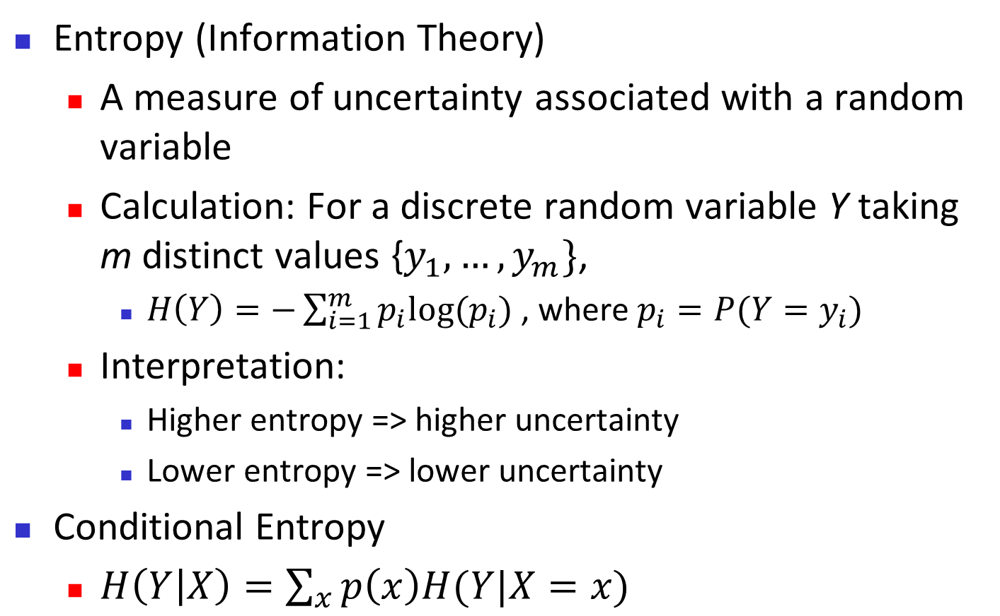
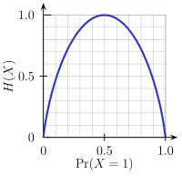
Brief Review of Entropy
m = 2
‹#›

Slide 12
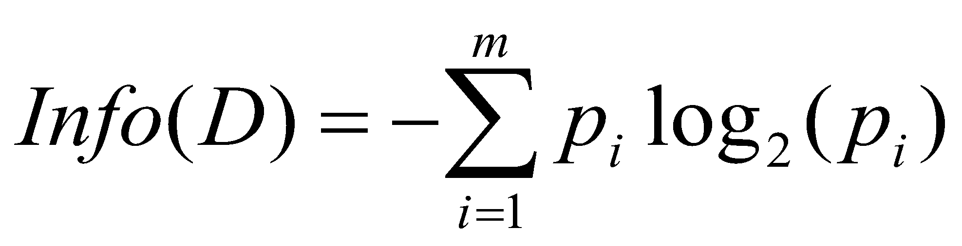
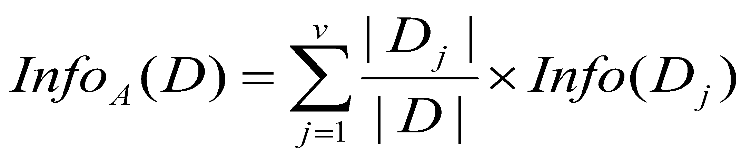
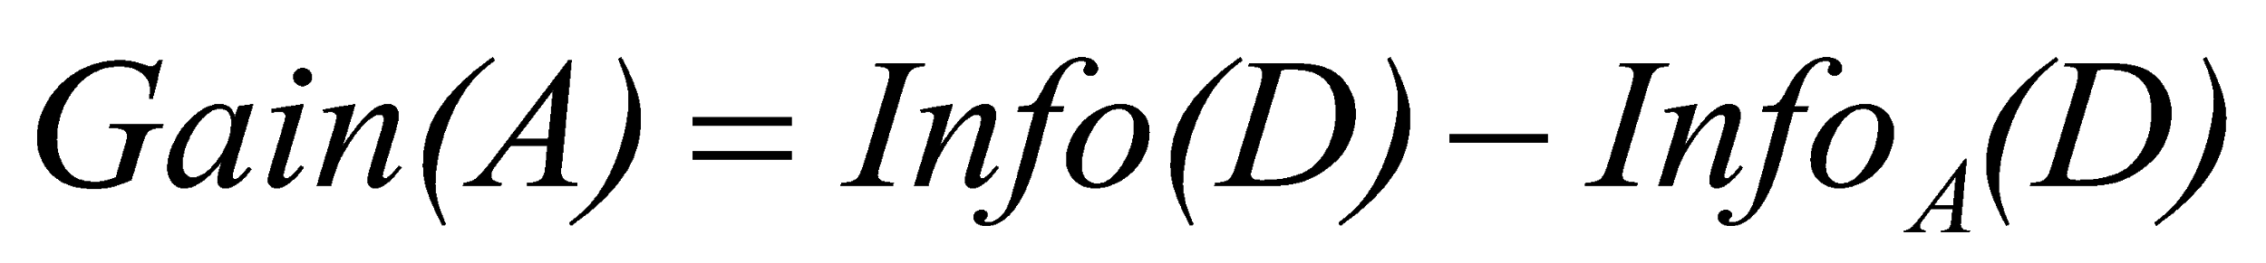
Attribute Selection Measure: Information Gain (ID3/C4.5)
Select the attribute with the highest information gain
Let p_{i} be the probability that an arbitrary tuple in D belongs to class C_{i}, estimated by |C_{i, D}|/|D|
Expected information (entropy) needed to classify a tuple in D:
Information needed (after using A to split D into v partitions) to classify D:
Information gained by branching on attribute A
‹#›

Slide 13
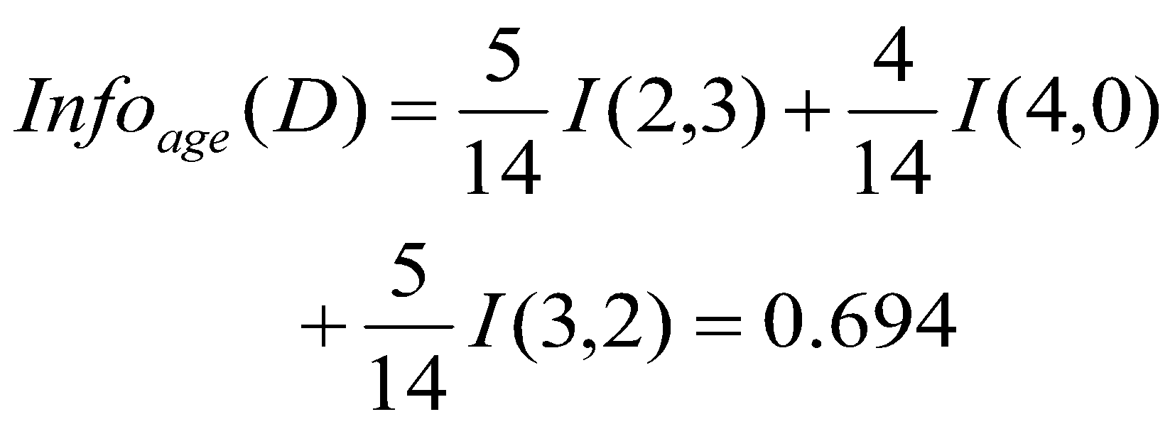
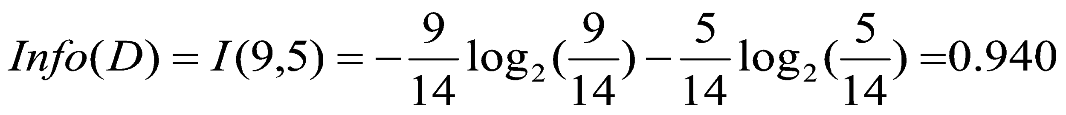
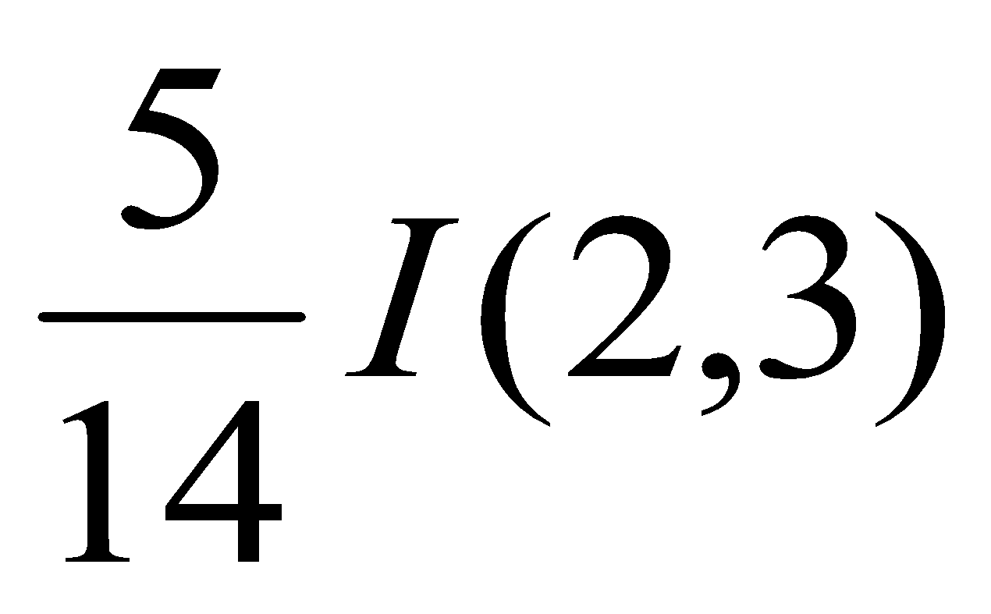
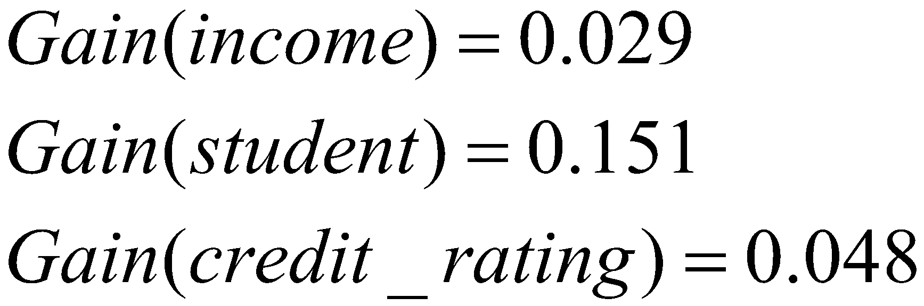
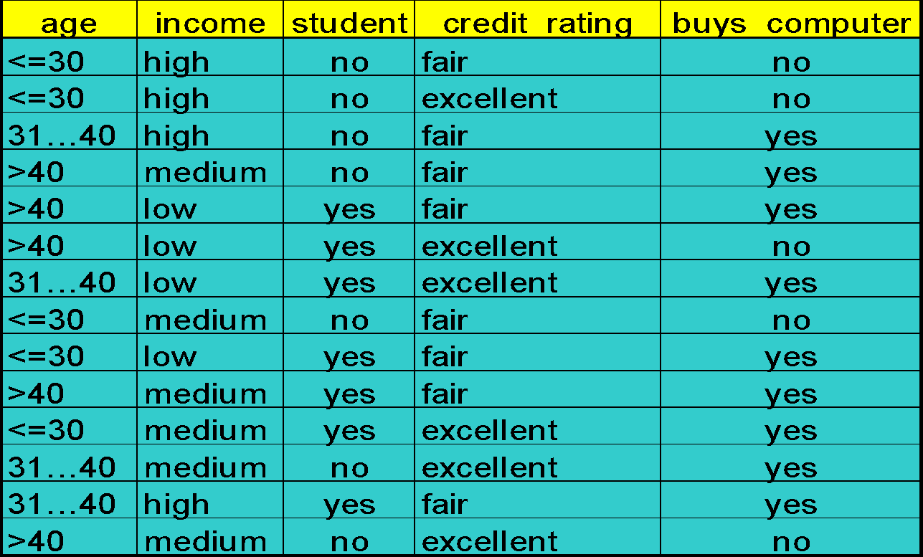
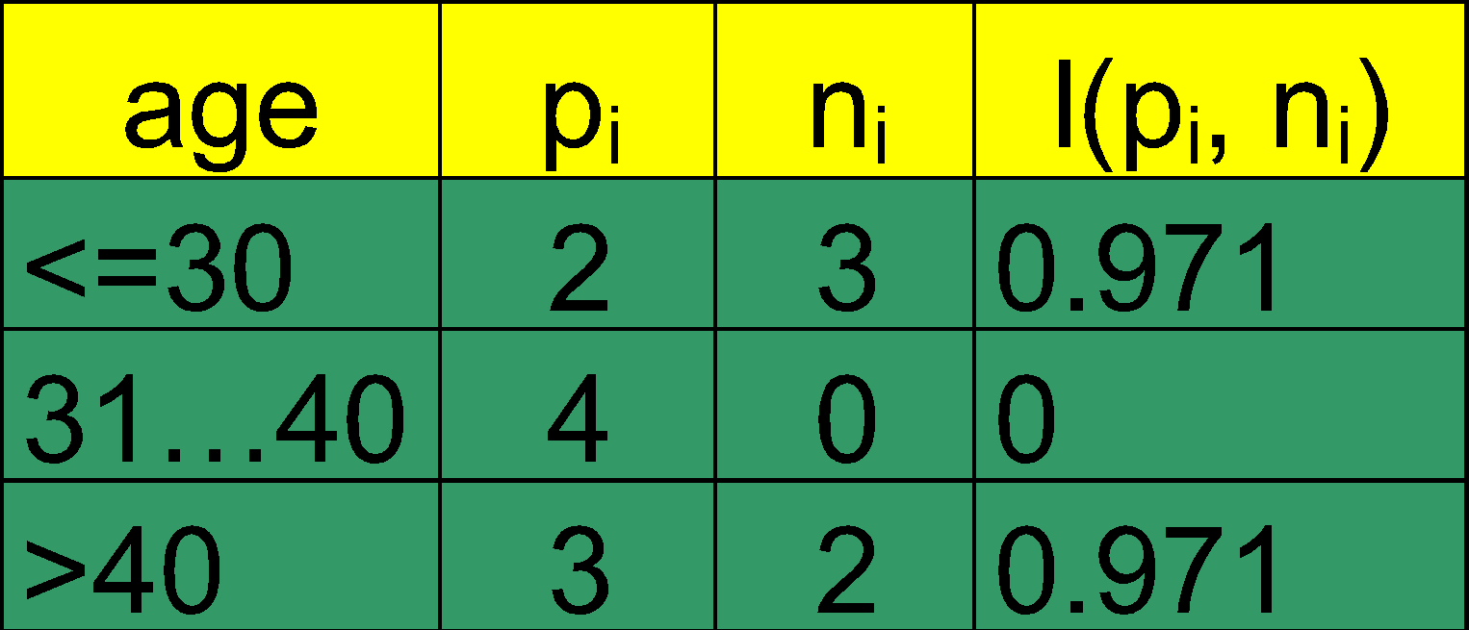
Attribute Selection: Information Gain
Class P: buys_computer = “yes”
Class N: buys_computer = “no”
means “age <=30” has 5 out of 14 samples, with 2 yes’es and 3 no’s. Hence
Similarly,
‹#›

Slide 14
Computing Information-Gain for Continuous-Valued Attributes
Let attribute A be a continuous-valued attribute
Must determine the best split point for A
Sort the value A in increasing order
Typically, the midpoint between each pair of adjacent values is considered as a possible split point
(a_{i}+a_{i+1})/2 is the midpoint between the values of a_{i} and a_{i+1}
The point with the minimum expected information requirement for A is selected as the split-point for A
Split:
D1 is the set of tuples in D satisfying A ≤ split-point, and D2 is the set of tuples in D satisfying A > split-point
‹#›

Slide 15
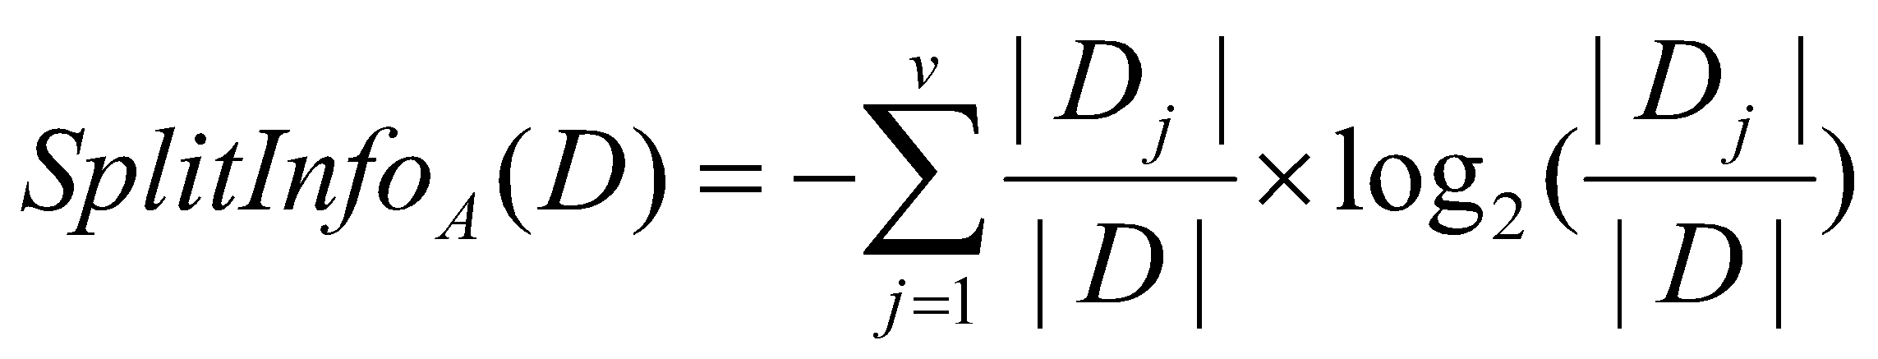
Gain Ratio for Attribute Selection (C4.5)
Information gain measure is biased towards attributes with a large number of values
C4.5 (a successor of ID3) uses gain ratio to overcome the problem (normalization to information gain)
GainRatio(A) = Gain(A)/SplitInfo(A)
Ex.
gain_ratio(income) = 0.029/1.557 = 0.019
The attribute with the maximum gain ratio is selected as the splitting attribute
‹#›

Slide 16
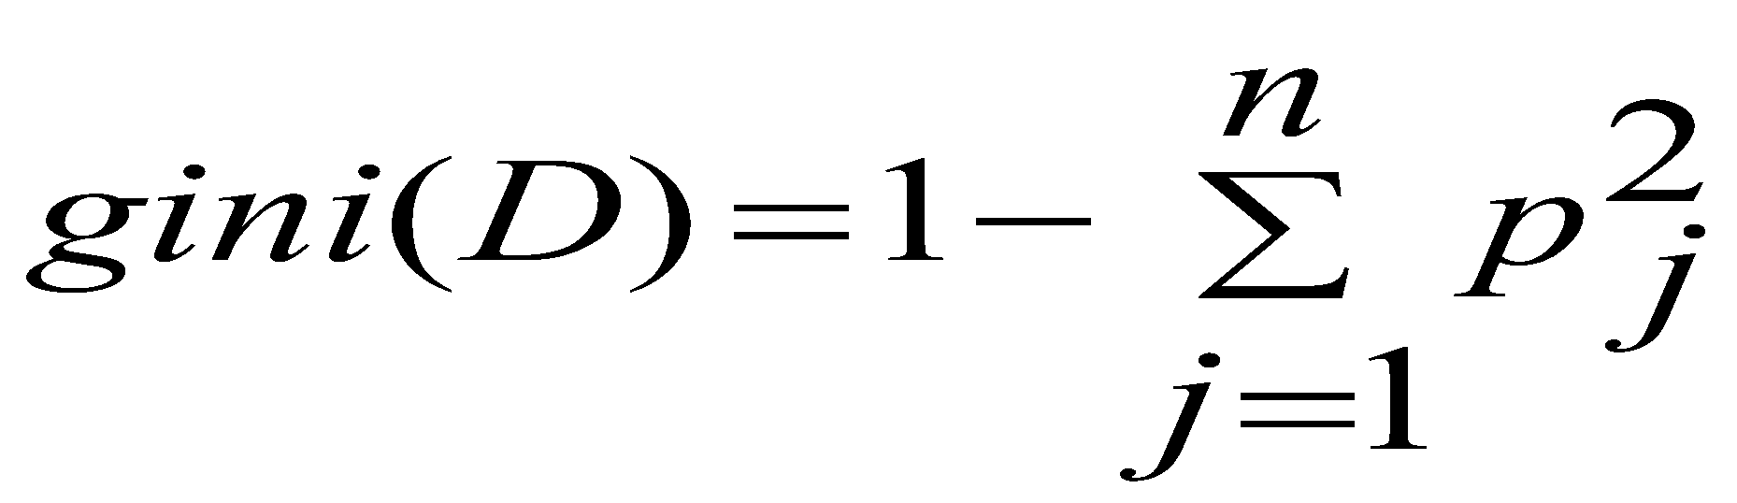
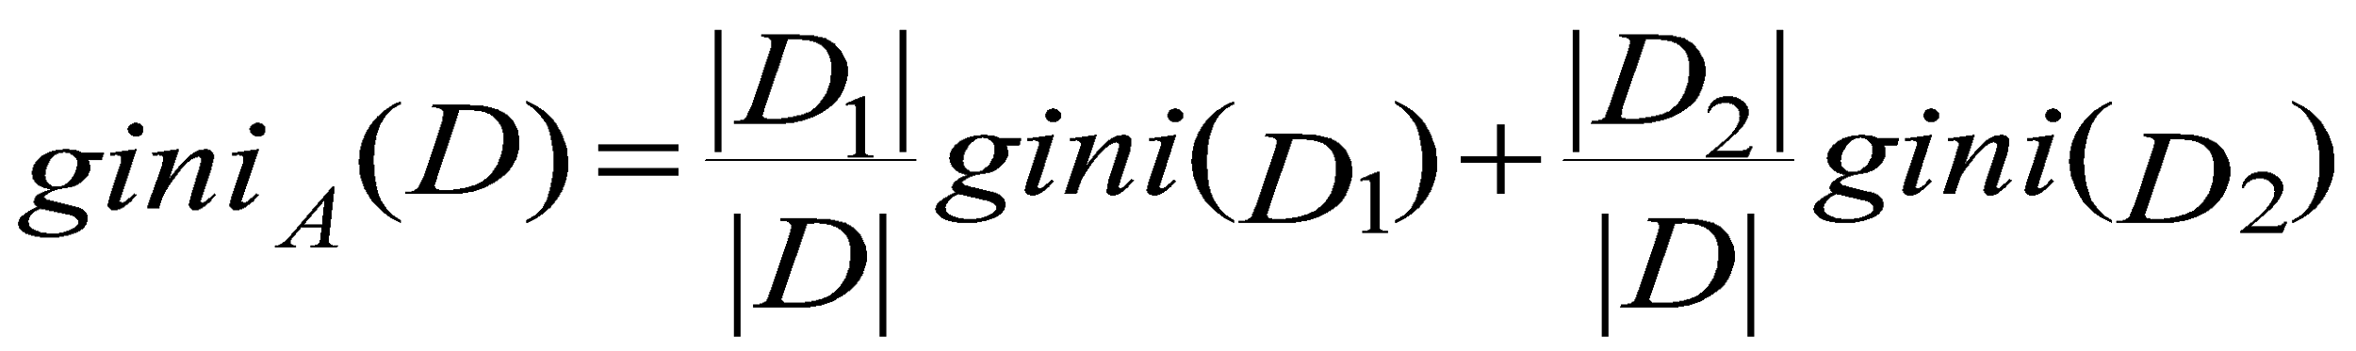
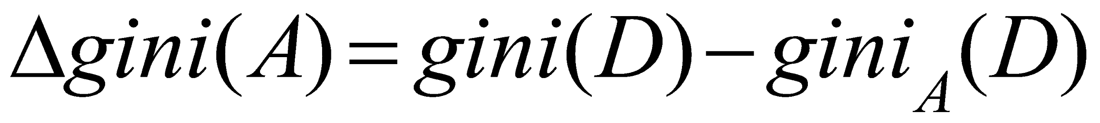
Gini Index (CART, IBM IntelligentMiner)
If a data set D contains examples from n classes, gini index, gini(D) is defined as
where p_{j} is the relative frequency of class j in D
If a data set D is split on A into two subsets D₁ and D₂, the gini index gini(D) is defined as
Reduction in Impurity:
The attribute provides the smallest gini_{split}(D) (or the largest reduction in impurity) is chosen to split the node (need to enumerate all the possible splitting points for each attribute)
‹#›

Slide 17
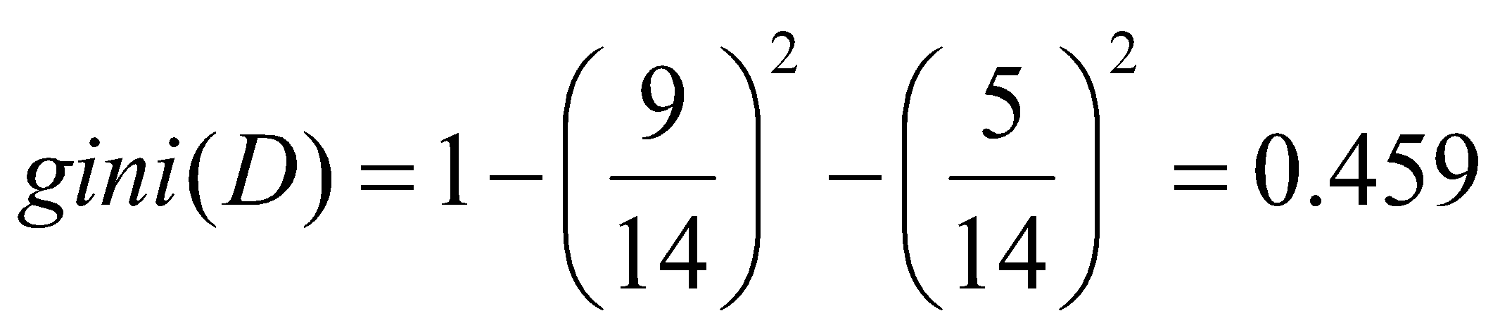
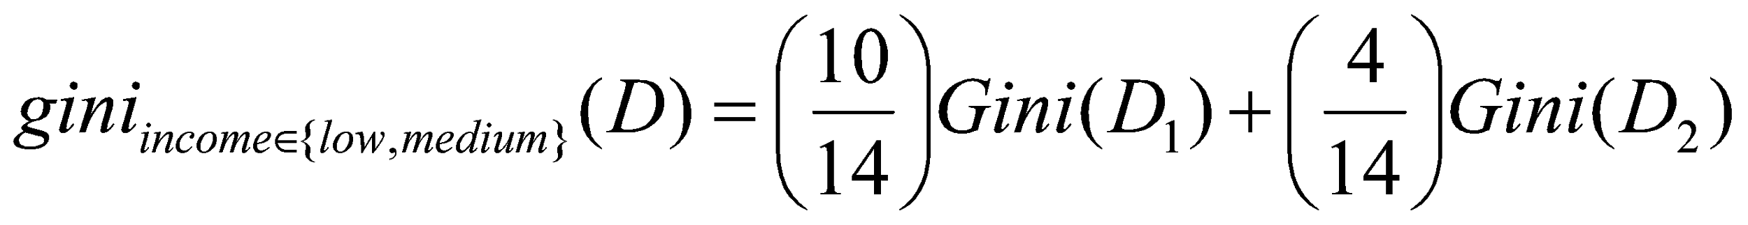
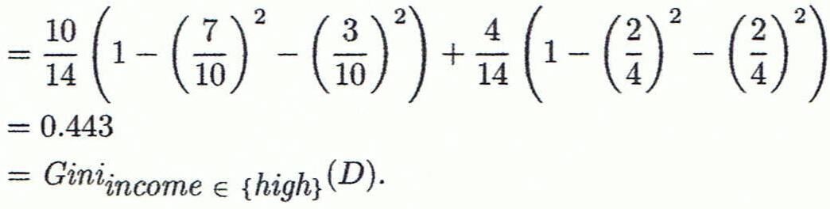
Computation of Gini Index
Ex. D has 9 tuples in buys_computer = “yes” and 5 in “no”
Suppose the attribute income partitions D into 10 in D₁: {low, medium} and 4 in D₂
Gini_{{low,high}} is 0.458; Gini_{{medium,high}} is 0.450. Thus, split on the {low,medium} (and {high}) since it has the lowest Gini index
All attributes are assumed continuous-valued
May need other tools, e.g., clustering, to get the possible split values
Can be modified for categorical attributes
‹#›

Slide 18
Comparing Attribute Selection Measures
The three measures, in general, return good results but
Information gain:
biased towards multivalued attributes
Gain ratio:
tends to prefer unbalanced splits in which one partition is much smaller than the others
Gini index:
biased to multivalued attributes
has difficulty when # of classes is large
tends to favor tests that result in equal-sized partitions and purity in both partitions
‹#›

Slide 19
Other Attribute Selection Measures
CHAID: a popular decision tree algorithm, measure based on χ² test for independence
C-SEP: performs better than info. gain and gini index in certain cases
G-statistic: has a close approximation to χ² distribution
MDL (Minimal Description Length) principle (i.e., the simplest solution is preferred):
The best tree as the one that requires the fewest # of bits to both (1) encode the tree, and (2) encode the exceptions to the tree
Multivariate splits (partition based on multiple variable combinations)
CART: finds multivariate splits based on a linear comb. of attrs.
Which attribute selection measure is the best?
Most give good results, none is significantly superior than others
‹#›

Slide 20
Overfitting and Tree Pruning
Overfitting: An induced tree may overfit the training data
Too many branches, some may reflect anomalies due to noise or outliers
Poor accuracy for unseen samples
Two approaches to avoid overfitting
Prepruning: Halt tree construction early ̵ do not split a node if this would result in the goodness measure falling below a threshold
Difficult to choose an appropriate threshold
Postpruning: Remove branches from a “fully grown” tree—get a sequence of progressively pruned trees
Use a set of data different from the training data to decide which is the “best pruned tree”
‹#›

Slide 21
Enhancements to Basic Decision Tree Induction
Allow for continuous-valued attributes
Dynamically define new discrete-valued attributes that partition the continuous attribute value into a discrete set of intervals
Handle missing attribute values
Assign the most common value of the attribute
Assign probability to each of the possible values
Attribute construction
Create new attributes based on existing ones that are sparsely represented
This reduces fragmentation, repetition, and replication
‹#›

Slide 22
Classification in Large Databases
Classification—a classical problem extensively studied by statisticians and machine learning researchers
Scalability: Classifying data sets with millions of examples and hundreds of attributes with reasonable speed
Why is decision tree induction popular?
relatively faster learning speed (than other classification methods)
convertible to simple and easy to understand classification rules
can use SQL queries for accessing databases
comparable classification accuracy with other methods
RainForest (VLDB’98 — Gehrke, Ramakrishnan & Ganti)
Builds an AVC-list (attribute, value, class label)
‹#›

Slide 23
Scalability Framework for RainForest
Separates the scalability aspects from the criteria that determine the quality of the tree
Builds an AVC-list: AVC (Attribute, Value, Class_label)
AVC-set (of an attribute X )
Projection of training dataset onto the attribute X and class label where counts of individual class label are aggregated
AVC-group (of a node n )
Set of AVC-sets of all predictor attributes at the node n
‹#›

Slide 24
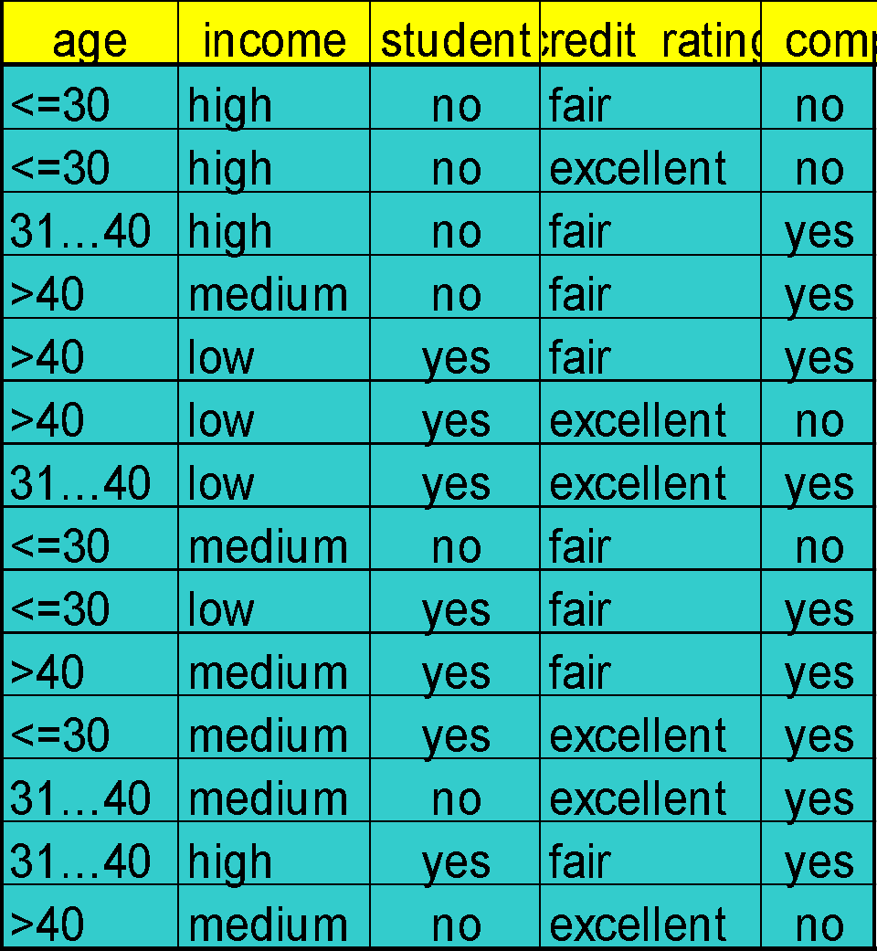
Rainforest: Training Set and Its AVC Sets
Training Examples
AVC-set on Age
AVC-set on income
Age | Buy_Computer
 | yes | no
<=30 | 2 | 3
31..40 | 4 | 0
>40 | 3 | 2
income | Buy_Computer
 | yes | no
high | 2 | 2
medium | 4 | 2
low | 3 | 1
AVC-set on
credit_rating
AVC-set on Student
student | Buy_Computer
 | yes | no
yes | 6 | 1
no | 3 | 4
Credit rating | Buy_Computer
 | yes | no
fair | 6 | 2
excellent | 3 | 3
‹#›

Slide 25
BOAT (Bootstrapped Optimistic Algorithm for Tree Construction)
Use a statistical technique called bootstrapping to create several smaller samples (subsets), each fits in memory
Each subset is used to create a tree, resulting in several trees
These trees are examined and used to construct a new tree T’
It turns out that T’ is very close to the tree that would be generated using the whole data set together
Adv: requires only two scans of DB, an incremental alg.
‹#›

Slide 26
Chapter 8. Classification: Basic Concepts
Classification: Basic Concepts
Decision Tree Induction
Bayes Classification Methods
Rule-Based Classification
Model Evaluation and Selection
Techniques to Improve Classification Accuracy: Ensemble Methods
Summary
‹#›

Slide 27
Bayesian Classification: Why?
A statistical classifier: performs probabilistic prediction, i.e., predicts class membership probabilities
Foundation: Based on Bayes’ Theorem.
Performance: A simple Bayesian classifier, naïve Bayesian classifier, has comparable performance with decision tree and selected neural network classifiers
Incremental: Each training example can incrementally increase/decrease the probability that a hypothesis is correct — prior knowledge can be combined with observed data
Standard: Even when Bayesian methods are computationally intractable, they can provide a standard of optimal decision making against which other methods can be measured
‹#›

Slide 28
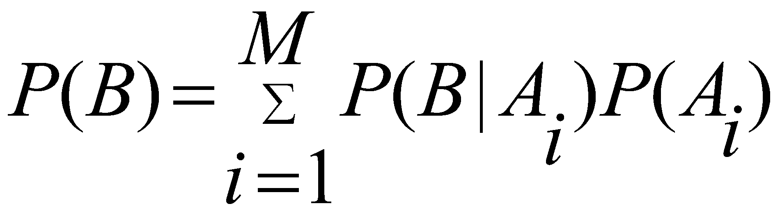
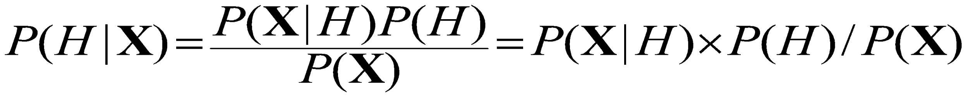
Bayes’ Theorem: Basics
Total probability Theorem:
Bayes’ Theorem:
Let X be a data sample (“evidence”): class label is unknown
Let H be a hypothesis that X belongs to class C
Classification is to determine P(H|X), (i.e., posteriori probability): the probability that the hypothesis holds given the observed data sample X
P(H) (prior probability): the initial probability
E.g., X will buy computer, regardless of age, income, …
P(X): probability that sample data is observed
P(X|H) (likelihood): the probability of observing the sample X, given that the hypothesis holds
E.g., Given that X will buy computer, the prob. that X is 31..40, medium income
‹#›

Slide 29
Prediction Based on Bayes’ Theorem
Given training data X, posteriori probability of a hypothesis H, P(H|X), follows the Bayes’ theorem
Informally, this can be viewed as
posteriori = likelihood x prior/evidence
Predicts X belongs to C_{i} iff the probability P(C_{i}|X) is the highest among all the P(C_{k}|X) for all the k classes
Practical difficulty: It requires initial knowledge of many probabilities, involving significant computational cost
‹#›

Slide 30
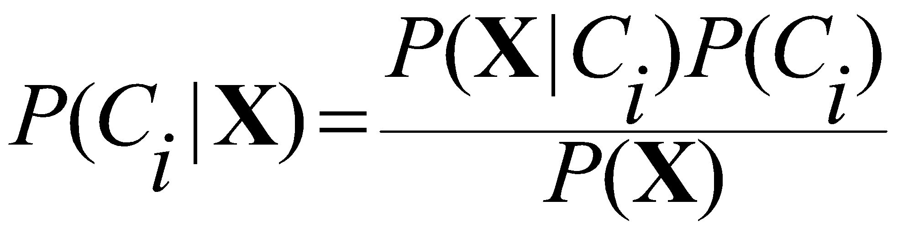
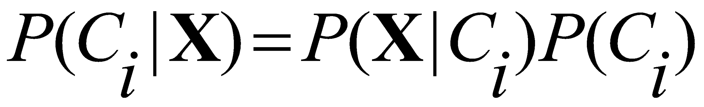
Classification Is to Derive the Maximum Posteriori
Let D be a training set of tuples and their associated class labels, and each tuple is represented by an n-D attribute vector X = (x₁, x₂, …, x_{n})
Suppose there are m classes C₁, C₂, …, C_{m}.
Classification is to derive the maximum posteriori, i.e., the maximal P(C_{i}|X)
This can be derived from Bayes’ theorem
Since P(X) is constant for all classes, only
needs to be maximized
‹#›

Slide 31
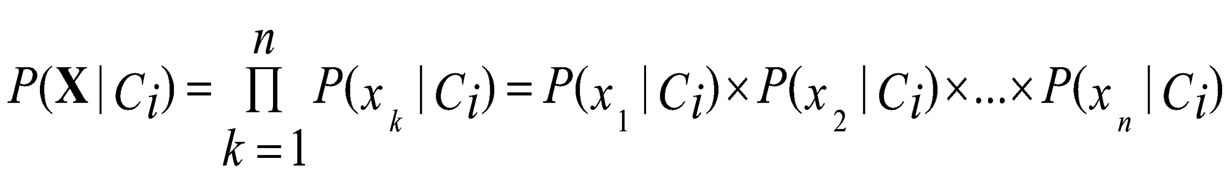
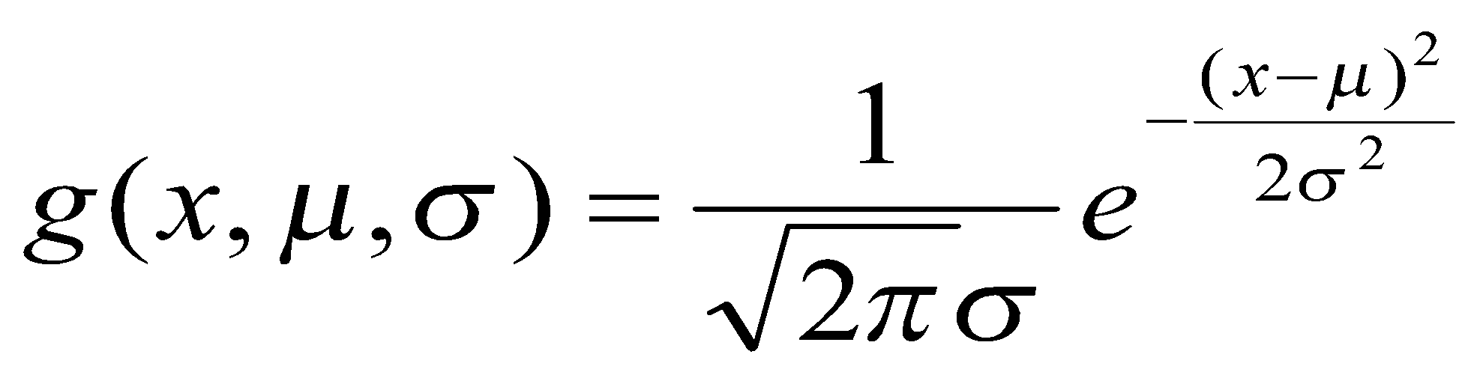
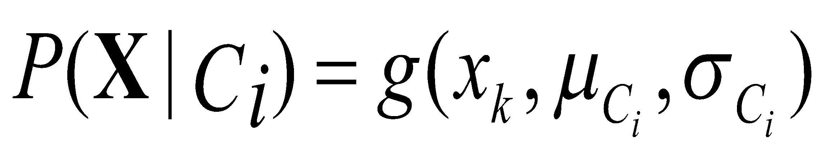
Naïve Bayes Classifier
A simplified assumption: attributes are conditionally independent (i.e., no dependence relation between attributes):
This greatly reduces the computation cost: Only counts the class distribution
If A_{k} is categorical, P(x_{k}|C_{i}) is the # of tuples in C_{i} having value x_{k} for A_{k} divided by |C_{i, D}| (# of tuples of C_{i} in D)
If A_{k} is continous-valued, P(x_{k}|C_{i}) is usually computed based on Gaussian distribution with a mean μ and standard deviation σ
and P(x_{k}|C_{i}) is
‹#›

Slide 32
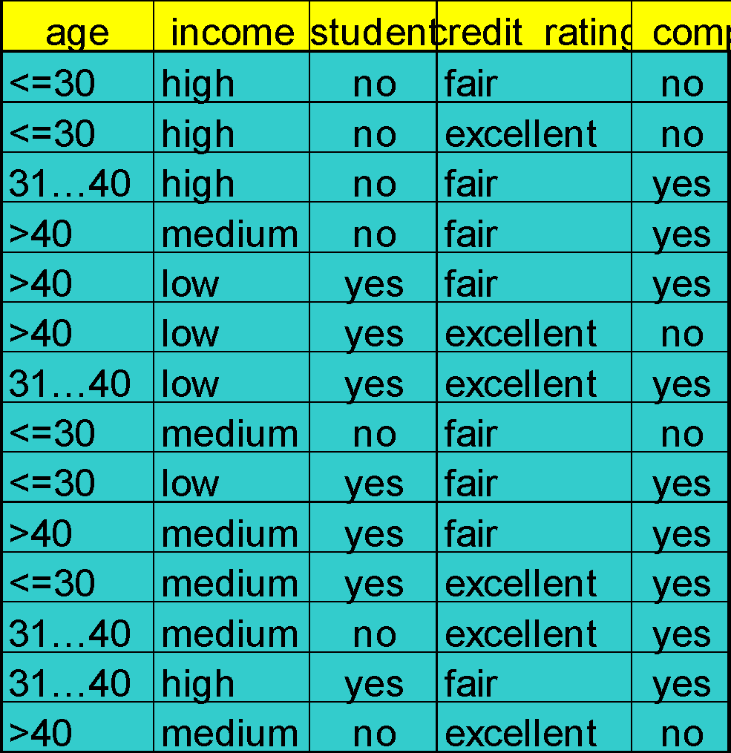
Naïve Bayes Classifier: Training Dataset
Class:
C1:buys_computer = ‘yes’
C2:buys_computer = ‘no’
Data to be classified:
X = (age <=30,
Income = medium,
Student = yes
Credit_rating = Fair)
‹#›

Slide 33
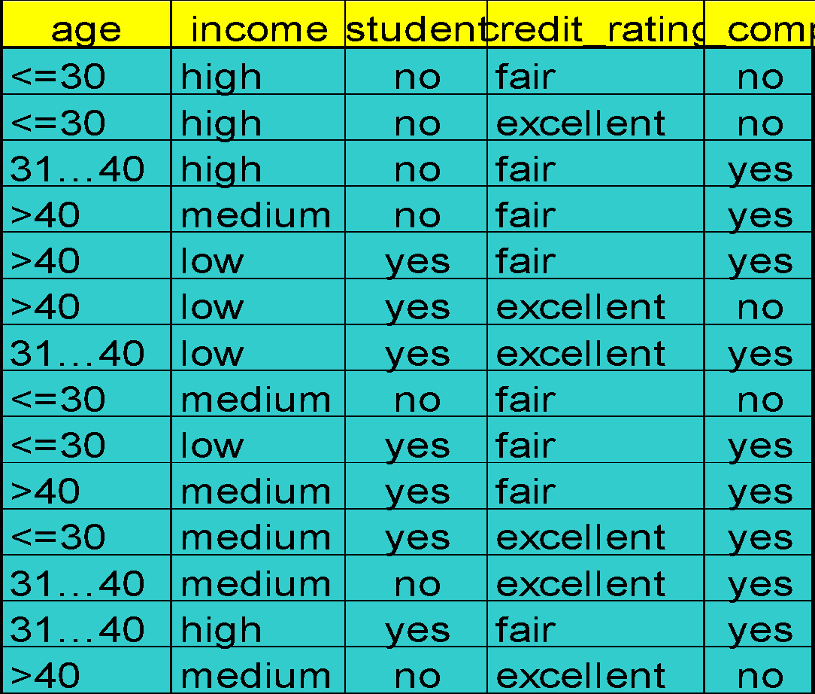
Naïve Bayes Classifier: An Example
P(C_{i}): P(buys_computer = “yes”) = 9/14 = 0.643
P(buys_computer = “no”) = 5/14= 0.357
Compute P(X|C_{i}) for each class
P(age = “<=30” | buys_computer = “yes”) = 2/9 = 0.222
P(age = “<= 30” | buys_computer = “no”) = 3/5 = 0.6
P(income = “medium” | buys_computer = “yes”) = 4/9 = 0.444
P(income = “medium” | buys_computer = “no”) = 2/5 = 0.4
P(student = “yes” | buys_computer = “yes) = 6/9 = 0.667
P(student = “yes” | buys_computer = “no”) = 1/5 = 0.2
P(credit_rating = “fair” | buys_computer = “yes”) = 6/9 = 0.667
P(credit_rating = “fair” | buys_computer = “no”) = 2/5 = 0.4
X = (age <= 30 , income = medium, student = yes, credit_rating = fair)
P(X|C_{i}) : P(X|buys_computer = “yes”) = 0.222 x 0.444 x 0.667 x 0.667 = 0.044
P(X|buys_computer = “no”) = 0.6 x 0.4 x 0.2 x 0.4 = 0.019
P(X|C_{i})*P(C_{i}) : P(X|buys_computer = “yes”) * P(buys_computer = “yes”) = 0.028
P(X|buys_computer = “no”) * P(buys_computer = “no”) = 0.007
Therefore, X belongs to class (“buys_computer = yes”)
‹#›

Slide 34
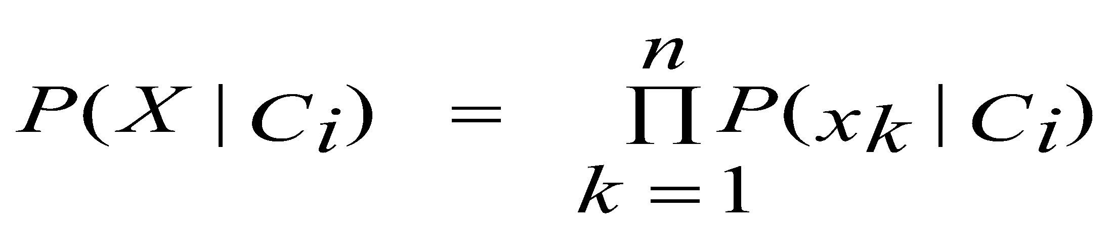
Avoiding the Zero-Probability Problem
Naïve Bayesian prediction requires each conditional prob. be non-zero. Otherwise, the predicted prob. will be zero
Ex. Suppose a dataset with 1000 tuples, income=low (0), income= medium (990), and income = high (10)
Use Laplacian correction (or Laplacian estimator)
Adding 1 to each case
Prob(income = low) = 1/1003
Prob(income = medium) = 991/1003
Prob(income = high) = 11/1003
The “corrected” prob. estimates are close to their “uncorrected” counterparts
‹#›

Slide 35
Naïve Bayes Classifier: Comments
Advantages
Easy to implement
Good results obtained in most of the cases
Disadvantages
Assumption: class conditional independence, therefore loss of accuracy
Practically, dependencies exist among variables
E.g., hospitals: patients: Profile: age, family history, etc.
Symptoms: fever, cough etc., Disease: lung cancer, diabetes, etc.
Dependencies among these cannot be modeled by Naïve Bayes Classifier
How to deal with these dependencies? Bayesian Belief Networks (Chapter 9)
‹#›

Slide 36
Chapter 8. Classification: Basic Concepts
Classification: Basic Concepts
Decision Tree Induction
Bayes Classification Methods
Rule-Based Classification
Model Evaluation and Selection
Techniques to Improve Classification Accuracy: Ensemble Methods
Summary
‹#›

Slide 37
Using IF-THEN Rules for Classification
Represent the knowledge in the form of IF-THEN rules
R: IF age = youth AND student = yes THEN buys_computer = yes
Rule antecedent/precondition vs. rule consequent
Assessment of a rule: coverage and accuracy
n_{covers} = # of tuples covered by R
n_{correct} = # of tuples correctly classified by R
coverage(R) = n_{covers} /|D| /* D: training data set */
accuracy(R) = n_{correct} / n_{covers}
If more than one rule are triggered, need conflict resolution
Size ordering: assign the highest priority to the triggering rules that has the “toughest” requirement (i.e., with the most attribute tests)
Class-based ordering: decreasing order of prevalence or misclassification cost per class
Rule-based ordering (decision list): rules are organized into one long priority list, according to some measure of rule quality or by experts
‹#›

Slide 38
Rule Extraction from a Decision Tree
Rules are easier to understand than large trees
One rule is created for each path from the root to a leaf
Each attribute-value pair along a path forms a conjunction: the leaf holds the class prediction
Rules are mutually exclusive and exhaustive
age?
<=30
31..40
>40
student?
yes
credit rating?
no
yes
excellent
fair
no
yes
no
yes
Example: Rule extraction from our buys_computer decision-tree
IF age = young AND student = no THEN buys_computer = no
IF age = young AND student = yes THEN buys_computer = yes
IF age = mid-age THEN buys_computer = yes
IF age = old AND credit_rating = excellent THEN buys_computer = no
IF age = old AND credit_rating = fair THEN buys_computer = yes
‹#›

Slide 39
Rule Induction: Sequential Covering Method
Sequential covering algorithm: Extracts rules directly from training data
Typical sequential covering algorithms: FOIL, AQ, CN2, RIPPER
Rules are learned sequentially, each for a given class C_{i} will cover many tuples of C_{i} but none (or few) of the tuples of other classes
Steps:
Rules are learned one at a time
Each time a rule is learned, the tuples covered by the rules are removed
Repeat the process on the remaining tuples until termination condition, e.g., when no more training examples or when the quality of a rule returned is below a user-specified threshold
Comp. w. decision-tree induction: learning a set of rules simultaneously
‹#›

Slide 40
Sequential Covering Algorithm
while (enough target tuples left)
generate a rule
remove positive target tuples satisfying this rule
Examples covered
by Rule 2
Examples covered
by Rule 1
Examples covered
by Rule 3
Positive examples
‹#›

Slide 41
Rule Generation
To generate a rule
while(true)
find the best predicate p
if foil-gain(p) > threshold then add p to current rule
else break
A3=1
A3=1&&A1=2
A3=1&&A1=2
&&A8=5
Positive examples
Negative examples
‹#›

Slide 42
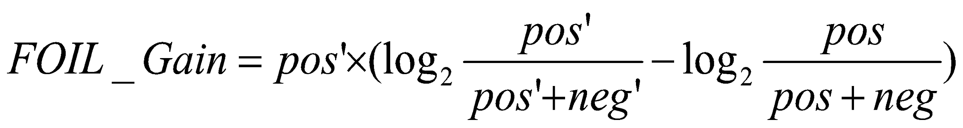
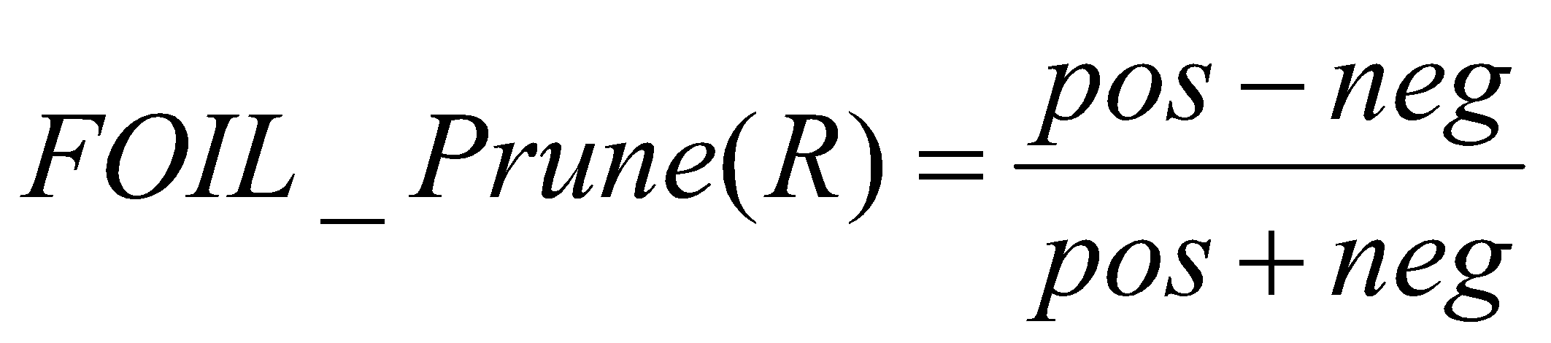
How to Learn-One-Rule?
Start with the most general rule possible: condition = empty
Adding new attributes by adopting a greedy depth-first strategy
Picks the one that most improves the rule quality
Rule-Quality measures: consider both coverage and accuracy
Foil-gain (in FOIL & RIPPER): assesses info_gain by extending condition
favors rules that have high accuracy and cover many positive tuples
Rule pruning based on an independent set of test tuples
Pos/neg are # of positive/negative tuples covered by R.
If FOIL_Prune is higher for the pruned version of R, prune R
‹#›

Slide 43
Chapter 8. Classification: Basic Concepts
Classification: Basic Concepts
Decision Tree Induction
Bayes Classification Methods
Rule-Based Classification
Model Evaluation and Selection
Techniques to Improve Classification Accuracy: Ensemble Methods
Summary
‹#›

Slide 44
Model Evaluation and Selection
Evaluation metrics: How can we measure accuracy? Other metrics to consider?
Use validation test set of class-labeled tuples instead of training set when assessing accuracy
Methods for estimating a classifier’s accuracy:
Holdout method, random subsampling
Cross-validation
Bootstrap
Comparing classifiers:
Confidence intervals
Cost-benefit analysis and ROC Curves
‹#›

Slide 45
Classifier Evaluation Metrics: Confusion Matrix
Confusion Matrix:
Actual class\Predicted class | C₁ | ¬ C₁
C₁ | True Positives (TP) | False Negatives (FN)
¬ C₁ | False Positives (FP) | True Negatives (TN)
Example of Confusion Matrix:
Actual class\Predicted class | buy_computer = yes | buy_computer = no | Total
buy_computer = yes | 6954 | 46 | 7000
buy_computer = no | 412 | 2588 | 3000
Total | 7366 | 2634 | 10000
Given m classes, an entry, CM_{i,j} in a confusion matrix indicates # of tuples in class i that were labeled by the classifier as class j
May have extra rows/columns to provide totals
‹#›

Slide 46
Classifier Evaluation Metrics: Accuracy, Error Rate, Sensitivity and Specificity
A\P | C | ¬C
C | TP | FN | P
¬C | FP | TN | N
 | P’ | N’ | All
Class Imbalance Problem:
One class may be rare, e.g. fraud, or HIV-positive
Significant majority of the negative class and minority of the positive class
Sensitivity: True Positive recognition rate
Sensitivity = TP/P
Specificity: True Negative recognition rate
Specificity = TN/N
Classifier Accuracy, or recognition rate: percentage of test set tuples that are correctly classified
Accuracy = (TP + TN)/All
Error rate: 1 – accuracy, or
Error rate = (FP + FN)/All
‹#›

Slide 47
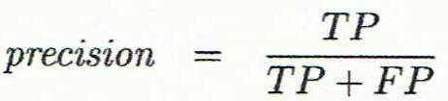
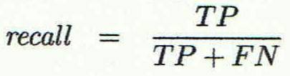
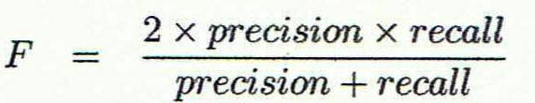
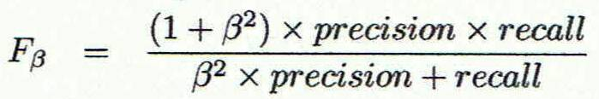
Classifier Evaluation Metrics: Precision and Recall, and F-measures
Precision: exactness – what % of tuples that the classifier labeled as positive are actually positive
Recall: completeness – what % of positive tuples did the classifier label as positive?
Perfect score is 1.0
Inverse relationship between precision & recall
F measure (F₁ or F-score): harmonic mean of precision and recall,
F_{ß}: weighted measure of precision and recall
assigns ß times as much weight to recall as to precision
‹#›

Slide 48
Classifier Evaluation Metrics: Example
Actual Class\Predicted class | cancer = yes | cancer = no | Total | Recognition(%)
cancer = yes | 90 | 210 | 300 | 30.00 (sensitivity
cancer = no | 140 | 9560 | 9700 | 98.56 (specificity)
Total | 230 | 9770 | 10000 | 96.40 (accuracy)
Precision = 90/230 = 39.13% Recall = 90/300 = 30.00%
A\P | C | ¬C
C | TP | FN | P
¬C | FP | TN | N
 | P’ | N’ | All
‹#›

Slide 49
Evaluating Classifier Accuracy: Holdout & Cross-Validation Methods
Holdout method
Given data is randomly partitioned into two independent sets
Training set (e.g., 2/3) for model construction
Test set (e.g., 1/3) for accuracy estimation
Random sampling: a variation of holdout
Repeat holdout k times, accuracy = avg. of the accuracies obtained
Cross-validation (k-fold, where k = 10 is most popular)
Randomly partition the data into k mutually exclusive subsets, each approximately equal size
At i-th iteration, use D_{i} as test set and others as training set
Leave-one-out: k folds where k = # of tuples, for small sized data
*Stratified cross-validation*: folds are stratified so that class dist. in each fold is approx. the same as that in the initial data
‹#›

Slide 50

Evaluating Classifier Accuracy: Bootstrap
Bootstrap
Works well with small data sets
Samples the given training tuples uniformly with replacement
i.e., each time a tuple is selected, it is equally likely to be selected again and re-added to the training set
Several bootstrap methods, and a common one is .632 boostrap
A data set with d tuples is sampled d times, with replacement, resulting in a training set of d samples. The data tuples that did not make it into the training set end up forming the test set. About 63.2% of the original data end up in the bootstrap, and the remaining 36.8% form the test set (since (1 – 1/d)^{d} ≈ e⁻¹ = 0.368)
Repeat the sampling procedure k times, overall accuracy of the model:
‹#›

Slide 51


Estimating Confidence Intervals: Classifier Models M₁ vs. M₂
Suppose we have 2 classifiers, M₁ and M₂, which one is better?
Use 10-fold cross-validation to obtain and
These mean error rates are just estimates of error on the true population of future data cases
What if the difference between the 2 error rates is just attributed to chance?
Use a test of statistical significance
Obtain confidence limits for our error estimates
‹#›

Slide 52
Estimating Confidence Intervals: Null Hypothesis
Perform 10-fold cross-validation
Assume samples follow a t distribution with k–1 degrees of freedom (here, k=10)
Use t-test (or Student’s t-test)
Null Hypothesis: M₁ & M₂ are the same
If we can reject null hypothesis, then
we conclude that the difference between M₁ & M₂ is statistically significant
Chose model with lower error rate
‹#›

Slide 53
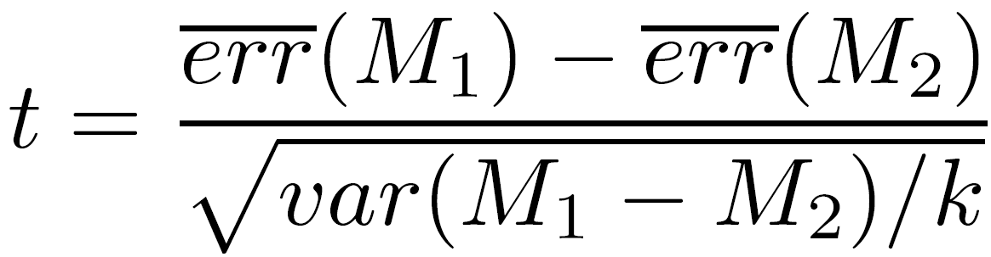
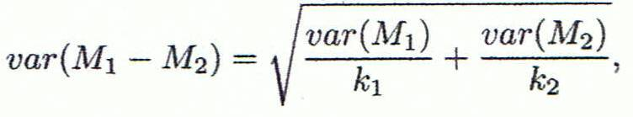
Estimating Confidence Intervals: t-test
If only 1 test set available: pairwise comparison
For i^{th} round of 10-fold cross-validation, the same cross partitioning is used to obtain err(M₁)_{i} and err(M₂)_{i}
Average over 10 rounds to get
t-test computes t-statistic with k-1 degrees of freedom:
If two test sets available: use non-paired t-test
and
where
where
where k₁ & k₂ are # of cross-validation samples used for M₁ & M₂, resp.
‹#›

Slide 54
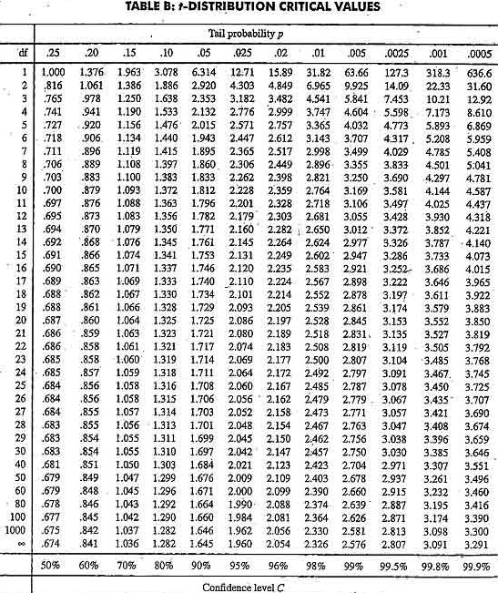
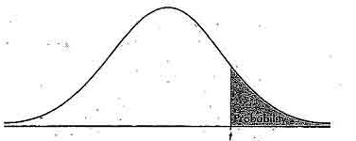
Estimating Confidence Intervals: Table for t-distribution
Symmetric
Significance level, e.g., sig = 0.05 or 5% means M₁ & M₂ are significantly different for 95% of population
Confidence limit, z = sig/2
‹#›

Slide 55
Estimating Confidence Intervals: Statistical Significance
Are M₁ & M₂ significantly different?
Compute t. Select significance level (e.g. sig = 5%)
Consult table for t-distribution: Find t value corresponding to k-1 degrees of freedom (here, 9)
t-distribution is symmetric: typically upper % points of distribution shown → look up value for confidence limit z=sig/2 (here, 0.025)
If t > z or t < -z, then t value lies in rejection region:
Reject null hypothesis that mean error rates of M₁ & M₂ are same
Conclude: statistically significant difference between M₁ & M₂
Otherwise, conclude that any difference is chance
‹#›

Slide 56
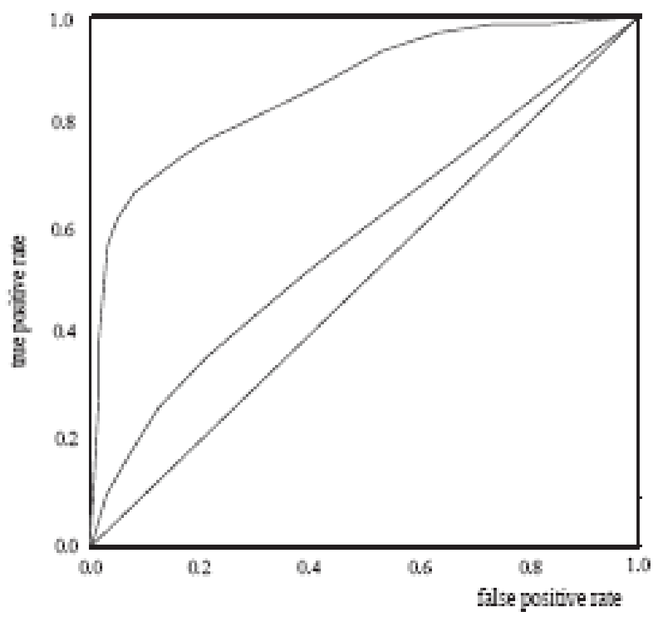
Model Selection: ROC Curves
ROC (Receiver Operating Characteristics) curves: for visual comparison of classification models
Originated from signal detection theory
Shows the trade-off between the true positive rate and the false positive rate
The area under the ROC curve is a measure of the accuracy of the model
Rank the test tuples in decreasing order: the one that is most likely to belong to the positive class appears at the top of the list
The closer to the diagonal line (i.e., the closer the area is to 0.5), the less accurate is the model
Vertical axis represents the true positive rate
Horizontal axis rep. the false positive rate
The plot also shows a diagonal line
A model with perfect accuracy will have an area of 1.0
‹#›

Slide 57
Issues Affecting Model Selection
Accuracy
classifier accuracy: predicting class label
Speed
time to construct the model (training time)
time to use the model (classification/prediction time)
Robustness: handling noise and missing values
Scalability: efficiency in disk-resident databases
Interpretability
understanding and insight provided by the model
Other measures, e.g., goodness of rules, such as decision tree size or compactness of classification rules
‹#›

Slide 58
Chapter 8. Classification: Basic Concepts
Classification: Basic Concepts
Decision Tree Induction
Bayes Classification Methods
Rule-Based Classification
Model Evaluation and Selection
Techniques to Improve Classification Accuracy: Ensemble Methods
Summary
‹#›

Slide 59
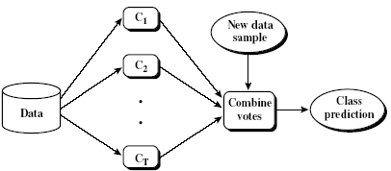
Ensemble Methods: Increasing the Accuracy
Ensemble methods
Use a combination of models to increase accuracy
Combine a series of k learned models, M₁, M₂, …, M_{k}, with the aim of creating an improved model M*
Popular ensemble methods
Bagging: averaging the prediction over a collection of classifiers
Boosting: weighted vote with a collection of classifiers
Ensemble: combining a set of heterogeneous classifiers
‹#›

Slide 60
Bagging: Boostrap Aggregation
Analogy: Diagnosis based on multiple doctors’ majority vote
Training
Given a set D of d tuples, at each iteration i, a training set D_{i} of d tuples is sampled with replacement from D (i.e., bootstrap)
A classifier model M_{i} is learned for each training set D_{i}
Classification: classify an unknown sample X
Each classifier M_{i} returns its class prediction
The bagged classifier M* counts the votes and assigns the class with the most votes to X
Prediction: can be applied to the prediction of continuous values by taking the average value of each prediction for a given test tuple
Accuracy
Often significantly better than a single classifier derived from D
For noise data: not considerably worse, more robust
Proved improved accuracy in prediction
‹#›

Slide 61
Boosting
Analogy: Consult several doctors, based on a combination of weighted diagnoses—weight assigned based on the previous diagnosis accuracy
How boosting works?
Weights are assigned to each training tuple
A series of k classifiers is iteratively learned
After a classifier M_{i} is learned, the weights are updated to allow the subsequent classifier, M_{i+1}, to pay more attention to the training tuples that were misclassified by M_{i}
The final M* combines the votes of each individual classifier, where the weight of each classifier's vote is a function of its accuracy
Boosting algorithm can be extended for numeric prediction
Comparing with bagging: Boosting tends to have greater accuracy, but it also risks overfitting the model to misclassified data
‹#›

Slide 62
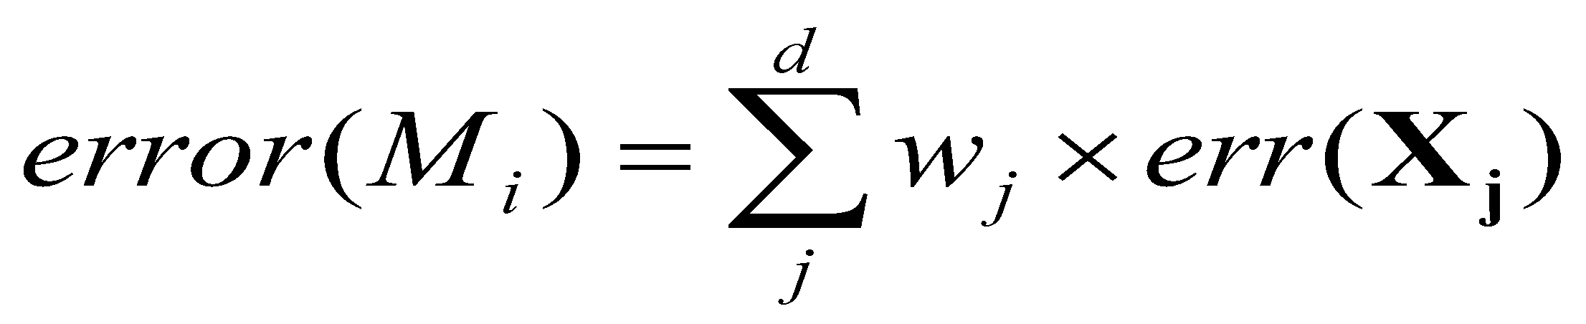
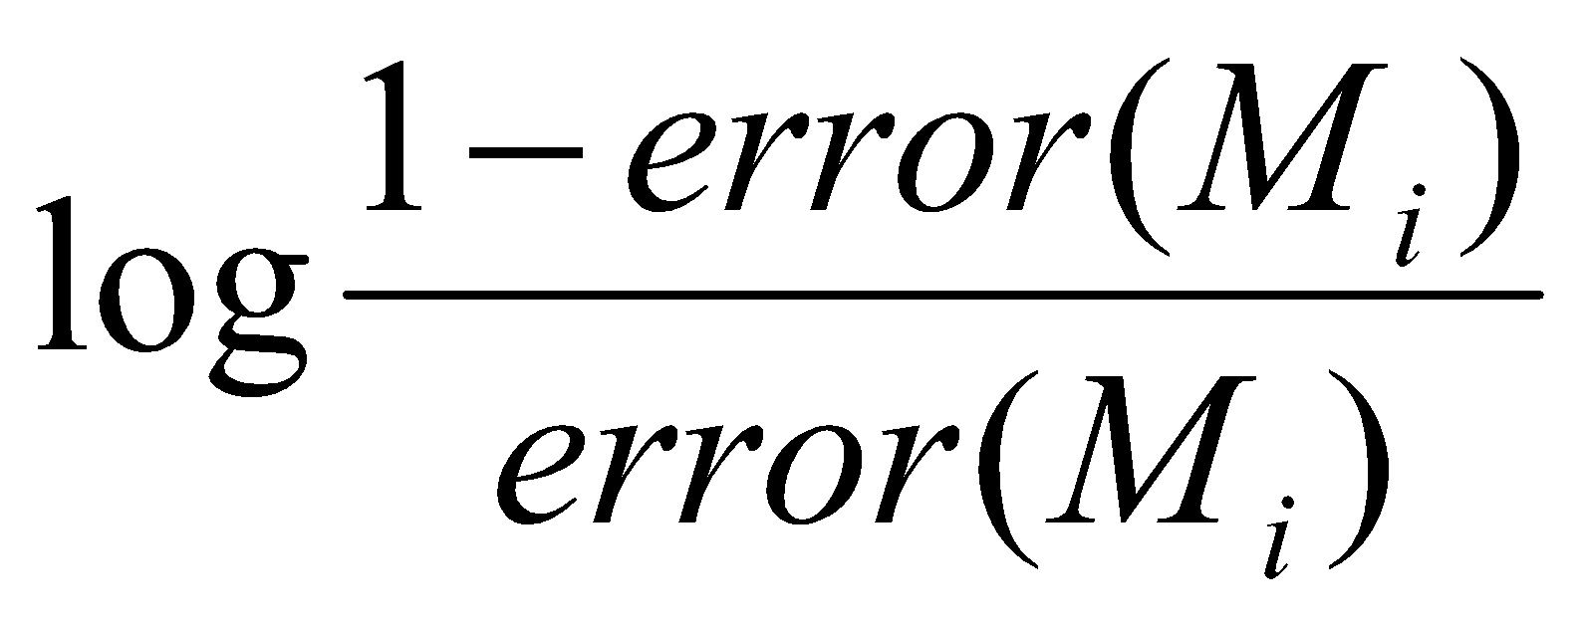
Adaboost (Freund and Schapire, 1997)
Given a set of d class-labeled tuples, (X₁, y₁), …, (X_{d}, y_{d})
Initially, all the weights of tuples are set the same (1/d)
Generate k classifiers in k rounds. At round i,
Tuples from D are sampled (with replacement) to form a training set D_{i} of the same size
Each tuple’s chance of being selected is based on its weight
A classification model M_{i} is derived from D_{i}
Its error rate is calculated using D_{i} as a test set
If a tuple is misclassified, its weight is increased, o.w. it is decreased
Error rate: err(X_{j}) is the misclassification error of tuple X_{j}. Classifier M_{i} error rate is the sum of the weights of the misclassified tuples:
The weight of classifier M_{i}’s vote is
‹#›

Slide 63
Random Forest (Breiman 2001)
Random Forest:
Each classifier in the ensemble is a decision tree classifier and is generated using a random selection of attributes at each node to determine the split
During classification, each tree votes and the most popular class is returned
Two Methods to construct Random Forest:
Forest-RI (random input selection): Randomly select, at each node, F attributes as candidates for the split at the node. The CART methodology is used to grow the trees to maximum size
Forest-RC (random linear combinations): Creates new attributes (or features) that are a linear combination of the existing attributes (reduces the correlation between individual classifiers)
Comparable in accuracy to Adaboost, but more robust to errors and outliers
Insensitive to the number of attributes selected for consideration at each split, and faster than bagging or boosting
‹#›

Slide 64
Classification of Class-Imbalanced Data Sets
Class-imbalance problem: Rare positive example but numerous negative ones, e.g., medical diagnosis, fraud, oil-spill, fault, etc.
Traditional methods assume a balanced distribution of classes and equal error costs: not suitable for class-imbalanced data
Typical methods for imbalance data in 2-class classification:
Oversampling: re-sampling of data from positive class
Under-sampling: randomly eliminate tuples from negative class
Threshold-moving: moves the decision threshold, t, so that the rare class tuples are easier to classify, and hence, less chance of costly false negative errors
Ensemble techniques: Ensemble multiple classifiers introduced above
Still difficult for class imbalance problem on multiclass tasks
‹#›

Slide 65
Chapter 8. Classification: Basic Concepts
Classification: Basic Concepts
Decision Tree Induction
Bayes Classification Methods
Rule-Based Classification
Model Evaluation and Selection
Techniques to Improve Classification Accuracy: Ensemble Methods
Summary
‹#›

Slide 66
Summary (I)
Classification is a form of data analysis that extracts models describing important data classes.
Effective and scalable methods have been developed for decision tree induction, Naive Bayesian classification, rule-based classification, and many other classification methods.
Evaluation metrics include: accuracy, sensitivity, specificity, precision, recall, F measure, and F_{ß} measure.
Stratified k-fold cross-validation is recommended for accuracy estimation. Bagging and boosting can be used to increase overall accuracy by learning and combining a series of individual models.
‹#›

Slide 67
Summary (II)
Significance tests and ROC curves are useful for model selection.
There have been numerous comparisons of the different classification methods; the matter remains a research topic
No single method has been found to be superior over all others for all data sets
Issues such as accuracy, training time, robustness, scalability, and interpretability must be considered and can involve trade-offs, further complicating the quest for an overall superior method
‹#›

